Slide 1
CHANGING DIRECT SPEECH TO INDIRECT SPEECH
BY
FITRIS ROZA. S.S, M.Pd

Slide 2
DIRECT SPEECH
Sharon asked, “How are you?”
Steve said, “I’m fine thanks. How about you?”
Sharon answered, I’m okay. What are you doing these days?”
Steve replied, “Not a lot, actually. Busy at work of course.”

Slide 3
DIRECT SPEECH
quoting the actual words of the speaker
use of verbatim sentences

Slide 4
INDIRECT/INDIRECT SPEECH
Sharon asked Steve if how is he.
Then Steve said that he’s fine. He also
asked Sharon the same thing.
Sharon answered that she is okay.
She asked him again
if what he has been doing these
days. Steve said that
he’s busy at work.

Slide 5
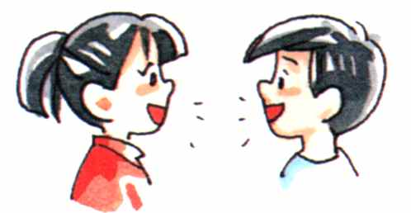
INDIRECT/INDIRECT SPEECH
reporting what has been said without quoting
the actual words of the speaker.

Slide 6
DIRECT VERSUS INDIRECT SPEECHS
Direct SPEECHs | INDIRECT SPEECHs
Clinton said, “I am very busy now.” | Clinton said that he was very busy then.
She said, “ my mother is writing letter.” | She said that his mother was writing letter.
He said, “His horse died in the night.” | He said that his horse had died in the night.
I said to him, “I did not believe you.” | I said to him that I did not believe him.
He said, “I was here yesterday.” | He said that he was there the day before.

Slide 7
DIRECT VERSUS INDIRECT SPEECHS
Direct SPEECHs | INDIRECT SPEECHs
Quoting the exact words of the speaker | Change some verb forms
Use of quotation marks (“…”) | No quotation marks
Use of comma | No comma

Slide 8
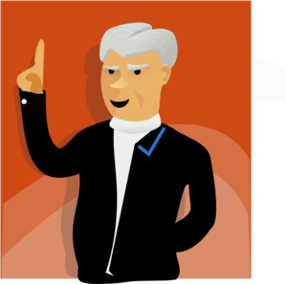
How do we change direct SPEECHs to INDIRECT SPEECHs?

Slide 9
CHANGING DIRECT SPEECHS TO INDIRECT SPEECHS
Use the conjunction ‘that’ before the indirect SPEECH.
The pronoun “I” is changed to “HE”.
The verb “am” is changed to “was”.
The adverb “now” is changed to “then”.

Slide 10
CHANGING DIRECT SPEECHS TO INDIRECT SPEECHS
When the reporting or principal verb is in the past tense, all the present tenses in the direct speech are changed into past tense.
NOTE: The shall of the future is changed into should. The will of the future is changed into would. The can and may of the future are changed into could and might respectively.
Conditions | Direct SPEECHs | INDIRECT SPEECHs
1. A simple present tense becomes simple past tense. | He said, “I am unwell.” | He said that he was unwell.
2. A present continuous tense becomes a past continuous. | He said, “ my mother is writing letter.” | He said that his mother was writing letter.
3. A present perfect becomes a past perfect. | He said, “I have passed the examination.” | He said that he had passed the examination.
4. As a rule the simple past tense becomes the past perfect tense. | He said, “His horse died in the night.” | He said that his horse had died in the night.

Slide 11
CHANGING DIRECT SPEECHS TO INDIRECT SPEECHS
B. The tenses will not change if the SPEECH is still relevant or
if it is a universal truth. We can often choose whether to
keep the original tenses or change them.
Direct SPEECHs | Indirect SPEECHs
1. “I know her address”, said John. | John said that he knows/knew her address.
2. The teacher said, “The earth goes round the sun.” | The teacher said that the earth goes/went round the sun.
3. She said, “German is easy to learn.” | She said that German was/is easy to learn.

Slide 12
CHANGING DIRECT SPEECHS TO INDIRECT SPEECHS
C. If the reporting verb is in present tense, the tenses of the direct speech do not change. For example, we may rewrite the above examples, putting the reporting verb in the present tense.
Direct SPEECHs | Indirect SPEECHs
1. He says, “I am unwell.” | He says that he is unwell.
2. He says, “ My mother is writing letter.” | He says that his mother is writing letter.
3. He says, “I have passed the examination.” | He says that he has passed the examination.
4. He says, “His horse died in the night.” | He says that his horse died in the night.

Slide 13
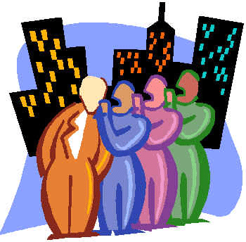
CHANGING DIRECT SPEECHS TO INDIRECT SPEECHS
D. The pronouns of the direct speech are changed where necessary, so that their relations with the reporter and his hearer, rather than with the original speaker are indicated.
Direct SPEECHs | Indirect SPEECHs
1. He said to me, “I do not believe you.” | He said that he did not believe me.
2. She said to him, “I do not believe you.” | She said to him that she did not believe him.
3. I said to him, “I did not believe you.” | I said to him that I did not believe him.
4.I said to you, “I do not believe you.” | I said to you that I do not believe you.

Slide 14
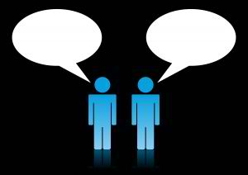
CHANGING DIRECT SPEECHS TO INDIRECT SPEECHS
E. Words expressing nearness in time or places are generally changed into words expressing distance.
Direct SPEECHs | Indirect SPEECHs
1. He said, “I am glad to be here this evening.” | He said that he was glad to be there that evening.
2. He said, “I was here yesterday.” | He said that he was there the day before.

Slide 15
CHANGING DIRECT SPEECHS TO INDIRECT SPEECHS
Now, let us see the words which get changed when the direct speech is changed into indirect speech.
Now becomes then
Here becomes there
Ago becomes before
Thus becomes so
Today becomes that day
Tomorrow becomes the next day
Yesterday becomes the day before
Last night becomes the night before
This becomes that
These becomes those

Slide 16
CHANGING DIRECT SPEECHS TO INDIRECT SPEECHS
F. How the questions used in the direct speech are changed into indirect speech?
Direct SPEECHs | Indirect SPEECHs
1. He said to me, “What are you doing?” | He asked me what I was doing.
2. A stranger asked me, “Where do you live?” | A stranger enquired where I lived.
3. The policemen said to us, “Where are you going?” | The policemen asked us where we were going.
4. He said, “Will you listen to such a man?” | He asked them whether they would listen to such a man. Would they, he asked, listen to such a man.
5. His angry mother jeered, “Do you suppose you know better than your father?” | His angry mother jeered and asked whether he supposed that he knew better than his father.

Slide 17
CHANGING DIRECT SPEECHS TO INDIRECT SPEECHS
G. How the commands and the requests in the direct speeches are changed are changed into indirect speeches? In reporting commands and requests, the indirect speech is introduced by some verb expressing commands and requests, and the imperative mood is changed into infinitive mood.
Direct SPEECHs | Indirect SPEECHs
1. Raja said to John, “Go away.” | Raja ordered John to go away.
2. He said to Mary, “Please wait here till I return.” | He requested Mary to wait there till he returned.
3. “Call the first witness”, said the Judge. | The Judge commanded them to call the first witness.
4. He shouted, “Let me go.” | He shouted to them to let him go.
5. He said, “Be quite and listen to my words”. | He urged them to be quite and listen to his words.

Slide 18
CHANGING DIRECT SPEECHS TO INDIRECT SPEECHS
H. How the exclamation and the wishes in the direct speeches are changed into indirect speeches? In reporting exclamation and wishes, the indirect speech is introduced by some verb expressing exclamation and wishes.
Direct SPEECHs | Indirect SPEECHs
1. He said, “Alas! I am undone”. | He exclaimed sadly that he was undone.
2. Alice said, “How clever I am?” | Alice exclaimed that he was very clever.
3. He said, “Bravo! You have done well.” | He applauded him, saying that he had done well.
4. “So help me, Heaven!” he cried, “I will never steal again”. | He called upon Heaven to witness his resolve never to resolve.

Slide 19
Try to transform these sentences…
1. “Who is that girl?” Maja asks Mari.
2. “Stop!” the policewoman halted the criminal.
3. Abe Lincoln said in his speech years ago, “Am I not destroying my enemies when I make friends of them?”
Direct to INDIRECT

Slide 20
Try to transform these sentences…
“Carmina, can you pass the iced tea to me?” Eunice asked.
“I am what I am,” Popeye said to Brutus.
Direct to INDIRECT

Slide 21
Now, try these…
Tom asks Jerry to stop making noises.
Angela told Booth that Temperance is not worthy of him.
He is telling us to shut up.
The prince requested his servant to look for girls who would fit the shoe in their feet.
The old lady commented that love was in the air last February 14.
INDIRECT to Direct

Slide 22
ANSWERS..DIRECT TO INDIRECT SPEECHrect to INDIRECT
1. Maja asks Mari who is that girl.
The police woman ordered the criminal to stop.
Abe Lincoln asked in his speech years ago if he was not destroying his enemies when he made friends of them.
Eunice requested Carmina if she could pass the iced tea to her.
Popeye told Brutus that he is what he is.

Slide 23
ANSWERS INDIRECT TO DIRECT SPEECH“Jerry, stop making noi“Jerry, stop making noises!” , Tom commanded.
“Jerry, stop making noises!” , Tom commanded.
“Temperance is not worthy of you,” Angela told Booth.
He tells us, “Shut up!”
“Look for girls who will fit the shoe in on their feet,” the prince requested the servant.
“Love is in the air,” said the old lady.

